Slide 1
Classroom Sound-field Systems
NOT a Green Alternative to Good Acoustics
Richard Riedel – Riedel Audio & Acoustics
Presented May 22, 2009 - Session 5aAA8 - Acoustical Society of America – Portland Oregon

Slide 2
Sound-field Systems
All Hear Systems | Calypso Control Systems | Panasonic | Smart Audio
Anchor Audio | Extron | Phonic Ear | Teachlogic
Atlas Sound | Front Row | Pure Resonance Audio | Tech Works
Audio Enhancement | Hamilton Electronics | Quam | Zvox
Azden | Hearit | Revolabs
Califone | Lightspeed | S. L. Drake

Slide 3
“Classroom noise hinders student learning.” – Brand F marketing literature

Slide 4
“Concert halls and auditoriums have sound systems designed to optimize acoustics. But what about classrooms?… Recent research indicates that classroom acoustics may be more critical to student achievement than we had previously thought… If you are looking to improve student achievement in your classroom, remodeling, or planning new facilities, I recommend taking a look at Brand A's products.”
David McQuin (media and technology specialist for Mankato (MN) Public Schools)
Notes:
The article contained no mention of actually improving the room’s acoustics to “enhance the classroom acoustic environment.” Its no wonder that the industry has grown as noted by this manufacturer’s marketing claim;

Slide 5
“The following (Brand F) products are significantly improving academic performance and assisting teachers in over 60 countries and tens of thousands of classrooms worldwide.”
Notes:
Obviously due to their financial interests, system manufacturers’ solution to the problem is to overpower excessive reverberation and background noise instead of correcting the room’s acoustics. And on first glance their solution can be very tempting to educators and school administrators, however, a closer look reveals one often overlooked consequence – the environmental impact of using classroom sound systems in every classroom.
In the interest of fairness I have used energy usage data from the most conservative unit I found as the basis for my calculations. The assumption being that as the playing field of manufacturers increases so would the technology.

Slide 6
What is the environmental impact of implementing systems in thousands of more classrooms?

Slide 7
System Comparison
Brand | AA Cells* | Hrs per Charge | Charger Power (W) | Charger Power/Day per Battery (W) | Receiver Power (W) | Receiver Power/Day (W) | Total System Power/Day (KwHrs)
A | 2 | 4 | 10 | 20 | 6 | 48 | .07
B | 2 | 7 | 10 | 35 | 6 | 48 | .08
C** | 2 | 8 | 3.5 | 14 | 40.5 | 324 | .34
D** | 2 | 8 | 3.5 | 14 | 100 | 800*** | .81
E | 1 | 6 | 2.5 | 15 | 3 | 24 | .04
E** |  |  |  |  | 36 | 288 | .33
*NiMH
**Combination receiver and amplifier units
***System also includes charger for an internal lead acid battery

Slide 8
Energy Usage Example
Total daily system wattage Brand E =.327KwHrs.

Slide 9
Energy Usage Example
Total daily system wattage Brand E =.327KwHrs.
Annual power consumption based on 180 day school year = 58.9KwHrs.

Slide 10
Energy Usage Example
Total daily system wattage Brand E =.327KwHrs.
Annual power consumption based on 180 day school year = 58.9KwHrs.
Annual electrical usage cost = $5.90/classroom
(DOE Jan 2009 commercial rate national average $.10/KwHr)

Slide 11
Energy Usage Example
Total daily system wattage Brand E =.327KwHrs.
Annual power consumption based on 180 day school year = 58.9KwHrs.
Annual electrical usage cost = $5.90/classroom
(DOE Jan 2009 commercial rate national average $.10/KwHr)
Annual power consumption with all US classrooms equipped = 147.1 M KwHrs.

Slide 12
Energy Usage Example
Total daily system wattage Brand E =.327KwHrs.
Annual power consumption based on 180 day school year = 58.9KwHrs.
Annual electrical usage cost = $5.90/classroom
(DOE Jan 2009 commercial rate national average $.10/KwHr)
Annual power consumption with all US classrooms equipped = 147.1 M KwHrs.
Annual electrical usage cost all classrooms = $14.6 M

Slide 13
Battery Expenses
NiMH batteries have a typical life cycle of 500 recharges.

Slide 14
Battery Expenses
NiMH batteries have a typical life cycle of 500 recharges.
Based on an average school year of 180 days, battery replacement will be necessary each 2.5-3 years.

Slide 15
Battery Expenses
NiMH batteries have a typical life cycle of 500 recharges.
Based on an average school year of 180 days, battery replacement will be necessary each 2.5-3 years.
Price per battery - $1.25

Slide 16
Battery Expenses
NiMH batteries have a typical life cycle of 500 recharges.
Based on an average school year of 180 days, battery replacement will be necessary each 2.5-3 years.
Price per battery - $1.25 x 2.5 Mil classrooms
Total replacement cost $3.1Mil for single battery systems

Slide 17
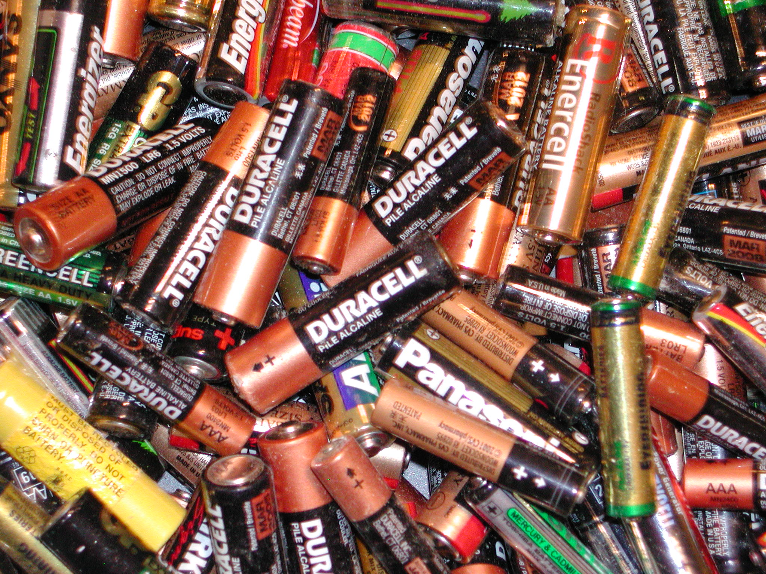
2.5 M Batteries would need to be disposed of every
2.5-3 years.
Notes:
0

Slide 18
Additional Expenses
All of the systems reviewed either include or recommend a second transmitter unit for student response.

Slide 19
Additional Expenses
All of the systems reviewed either include or recommend a second transmitter unit for student response.
Electricity costs associated with manufacturing and recycling of batteries or obsolete electronics.

Slide 20
Additional Expenses
All of the systems reviewed either include or recommend a second transmitter unit for student response.
Electricity costs associated with manufacturing and recycling of batteries or obsolete electronics.
Transportation costs

Slide 21
What’s Next?
Studies are needed to compare improvement in student performance for sound field systems vs. 12.60 compliant rooms. Individually and combined.

Slide 22
What’s Next?
Studies are needed to compare improvement in student performance for sound field systems vs. 12.60 compliant rooms. Individually and combined.
Encourage schools to invest in quieter air handling systems to reduce background noise. Replacement with more efficient units will result in an annual energy savings as opposed to an added annual expense.

Slide 23
What’s Next?
Limit the use of sound field systems to situations where necessary;
Large lecture spaces
When the presence of an in room AV program system results in the need to speak over an amplified prerecorded presentation.
Classes where aurally challenged students are present and additional amplification may be necessary.

Slide 24
Summary
Whenever sound field systems are necessary encourage the use of environmentally friendly components;
High efficiency charging device – possibly solar/light powered
Batteries using safe easily recycled chemical compositions and ones that utilize the most current technologies for extending their life expectancy-NiMH, Nickle/Zinc.
Recommend an energy efficiency rating system similar to that used by home appliances?
Inform schools about the environmental impact of universal implementation of sound field systems.

Slide 25
Acknowledgements
David Lubman – For suggesting I write this paper.
Pat Riedel – For reminding me to turn off my computer monitor due to all the power used by the little green flashing light.

Slide 26
Thank You

Slide 27
Questions?

